Slide 1
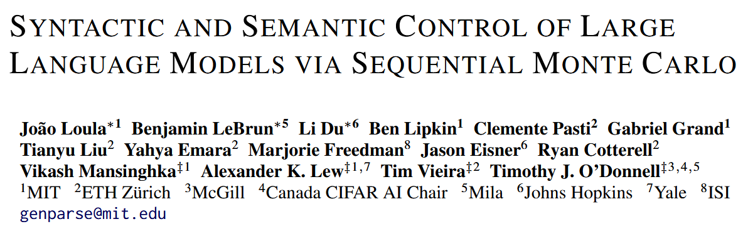
ICLR 2025 oral

Slide 2
Abstract
Many LM applications require generating text that conforms to syntactic or semantic constraints.
But exact generation from the resulting distribution is generally intractable.
We develop an architecture for controlled LM generation based on sequential Monte Carlo.
Flexibly incorporate domain-specific and problem-specific constraints.
Efficiently reallocate computations.
Experiments: small open-source LMs can outperform 8x larger models and closed-source, fined-tuned models with little overhead.
Python codegen for data science, text2SQL, goal inference, molecule synthesis.

Slide 3


Authors

Slide 4

Authors

Slide 5


Authors

Slide 6


Authors

Slide 7
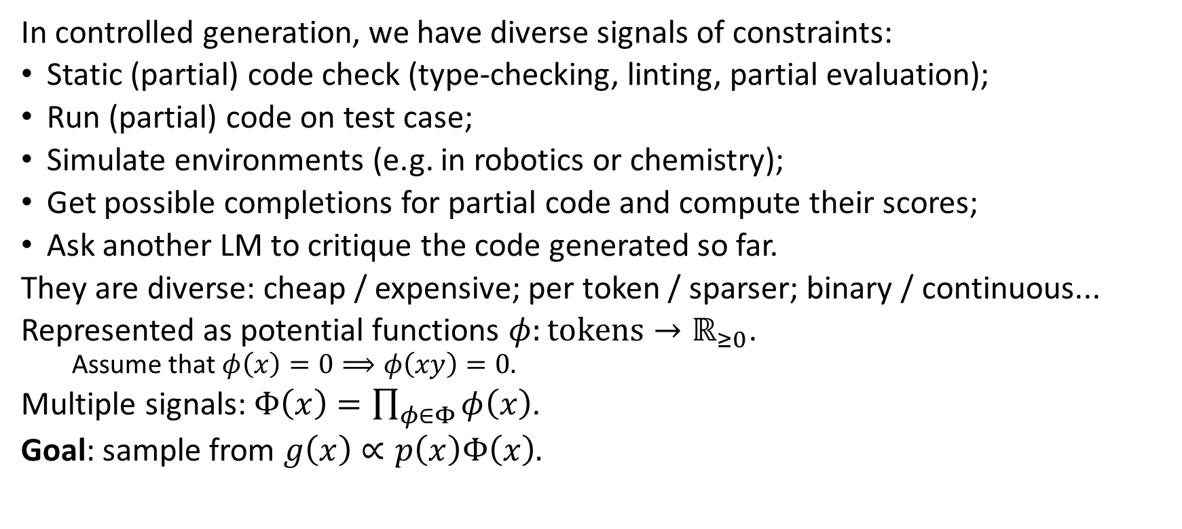
Introduction
In controlled generation, we have diverse signals of constraints:
Static (partial) code check (type-checking, linting, partial evaluation);
Run (partial) code on test case;
Simulate environments (e.g. in robotics or chemistry);
Get possible completions for partial code and compute their scores;
Ask another LM to critique the code generated so far.
They are diverse: cheap / expensive; per token / sparser; binary / continuous...
Represented as potential functions $φ:tokens→ℝ_{≥0}$.
Assume that $φ\left(x\right)=0⟹φ\left(xy\right)=0.$
Multiple signals: $Φ\left(x\right)=\prod_{φ∈Φ}{φ\left(x\right)}$.
Goal: sample from $g\left(x\right)∝p\left(x\right)Φ\left(x\right).$

Slide 8
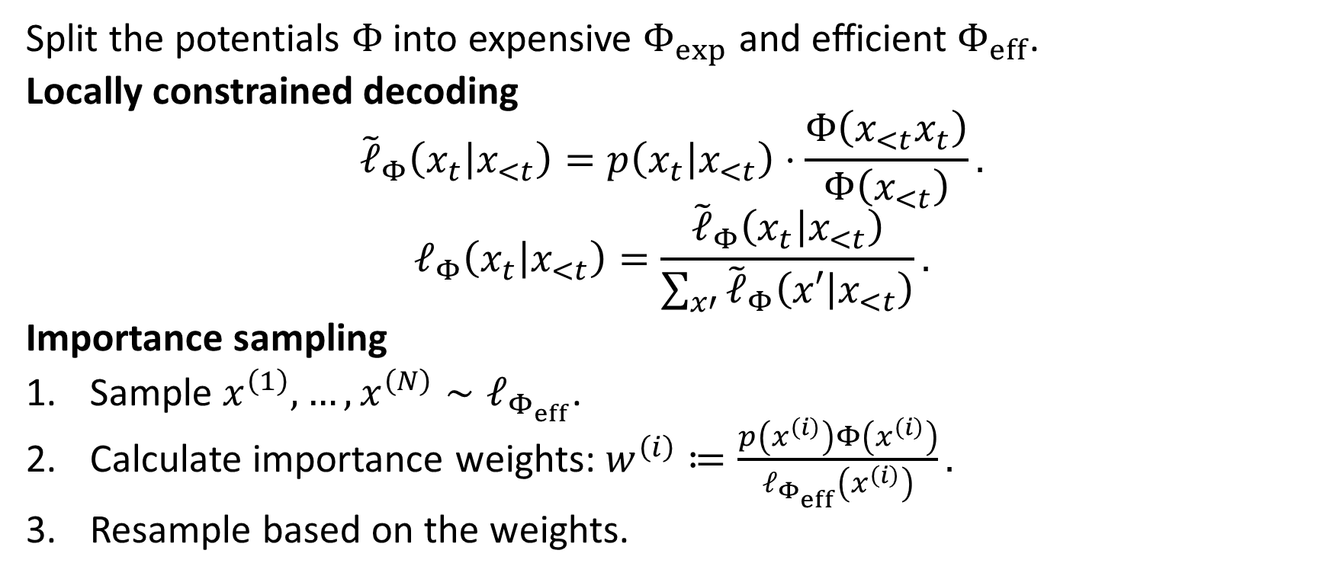
Previous methods
Split the potentials $Φ$ into expensive $Φ_{exp}$ and efficient $Φ_{eff}$.
Locally constrained decoding
$${\tilde{ℓ}}_{Φ}\left(x_{t} | x_{<t}\right)=p\left(x_{t} | x_{<t}\right)⋅\frac{Φ\left(x_{<t}x_{t}\right)}{Φ\left(x_{<t}\right)}.$$
$$ℓ_{Φ}\left(x_{t} | x_{<t}\right)=\frac{{\tilde{ℓ}}_{Φ}\left(x_{t} | x_{<t}\right)}{\sum_{x′}{{\tilde{ℓ}}_{Φ}\left(x′ | x_{<t}\right)}}.$$
Importance sampling
Sample $x^{\left(1\right)},…,x^{\left(N\right)}∼ℓ_{Φ_{eff}}$.
Calculate importance weights: $w^{\left(i\right)}≔\frac{p\left(x^{\left(i\right)}\right)Φ\left(x^{\left(i\right)}\right)}{ℓ_{Φ_{eff}}\left(x^{\left(i\right)}\right)}.$
Resample based on the weights.

Slide 9
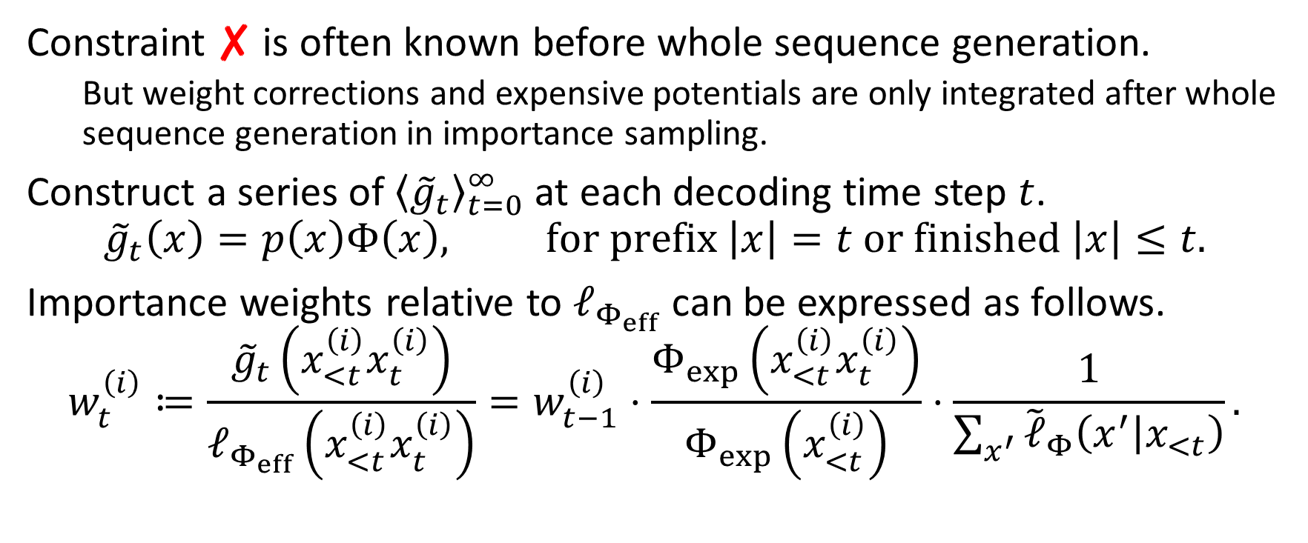
Sequential Monte Carlo
Constraint ✘ is often known before whole sequence generation.
But weight corrections and expensive potentials are only integrated after whole sequence generation in importance sampling.
Construct a series of ${\left\langle {\tilde{g}}_{t}\right\rangle }_{t=0}^{∞}$ at each decoding time step $t$.
$${\tilde{g}}_{t}\left(x\right)=p\left(x\right)Φ\left(x\right), for prefix \left|x\right|=t or finished \left|x\right|≤t.$$
Importance weights relative to $ℓ_{Φ_{eff}}$ can be expressed as follows.
$$w_{t}^{\left(i\right)}≔\frac{{\tilde{g}}_{t}\left(x_{<t}^{\left(i\right)}x_{t}^{\left(i\right)}\right)}{ℓ_{Φ_{eff}}\left(x_{<t}^{\left(i\right)}x_{t}^{\left(i\right)}\right)}=w_{t−1}^{\left(i\right)}⋅\frac{Φ_{exp}\left(x_{<t}^{\left(i\right)}x_{t}^{\left(i\right)}\right)}{Φ_{exp}\left(x_{<t}^{\left(i\right)}\right)}⋅\frac{1}{\sum_{x^{′}}{{\tilde{ℓ}}_{Φ}\left(x^{′} | x_{<t}\right)}}.$$

Slide 10
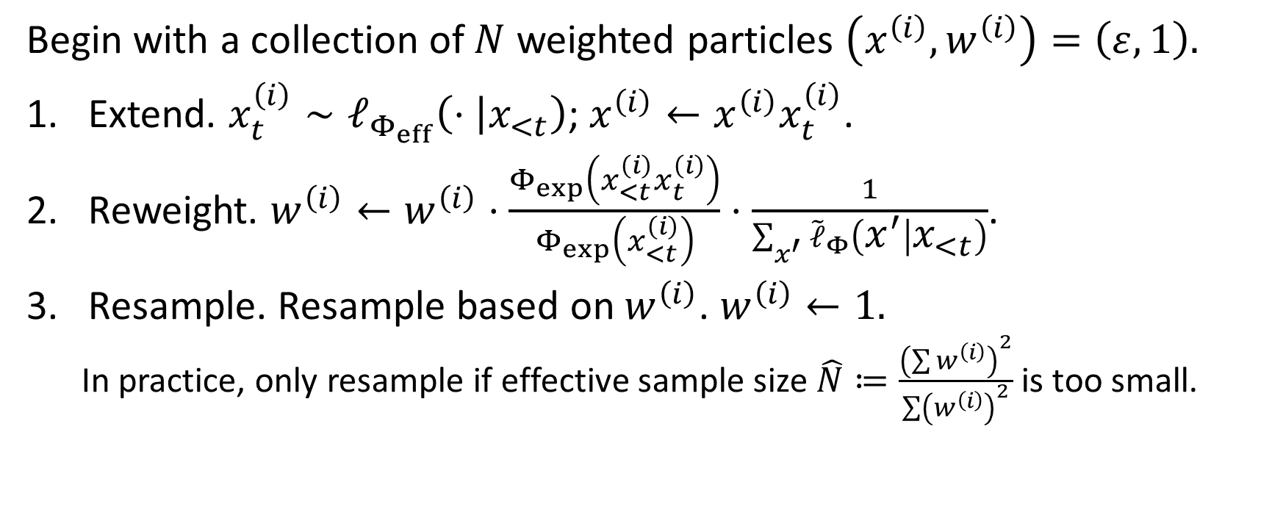
Monte Carlo Inference for Constrained Semantic Parsing
Begin with a collection of $N$ weighted particles $\left(x^{\left(i\right)},w^{\left(i\right)}\right)=\left(ε,1\right).$
Extend. $x_{t}^{\left(i\right)}∼ℓ_{Φ_{eff}}\left(⋅ | x_{<t}\right)$; $x^{\left(i\right)}←x^{\left(i\right)}x_{t}^{\left(i\right)}$.
Reweight. $w^{\left(i\right)}←w^{\left(i\right)}⋅\frac{Φ_{exp}\left(x_{<t}^{\left(i\right)}x_{t}^{\left(i\right)}\right)}{Φ_{exp}\left(x_{<t}^{\left(i\right)}\right)}⋅\frac{1}{\sum_{x^{′}}{{\tilde{ℓ}}_{Φ}\left(x^{′} | x_{<t}\right)}}$.
Resample. Resample based on $w^{\left(i\right)}$. $w^{\left(i\right)}←1.$
In practice, only resample if effective sample size $\hat{N}≔\frac{{\left(\sum{w^{\left(i\right)}}\right)}^{2}}{\sum{{\left(w^{\left(i\right)}\right)}^{2}}}$ is too small.

Slide 11
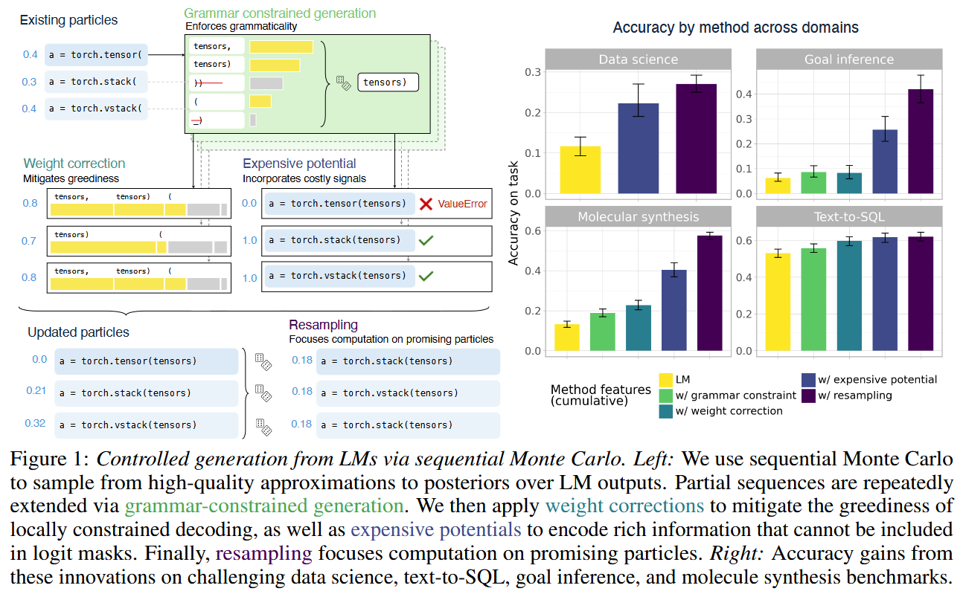
Monte Carlo Inference for Constrained Semantic Parsing

Slide 12

Further extension
$Φ_{eff}$ might still be too expensive to calculate on the entire vocab. We use cheap stochastic approximations as proposals. Of course they have to be corrected too.
${\tilde{g}}_{t}$ do not need to be token-by-token. E.g., in Python code, we use line of code as the unit.

Slide 13
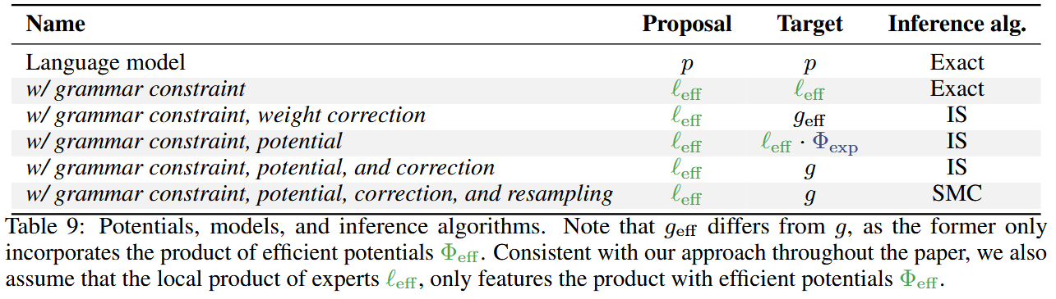
Experimental Settings

Slide 14
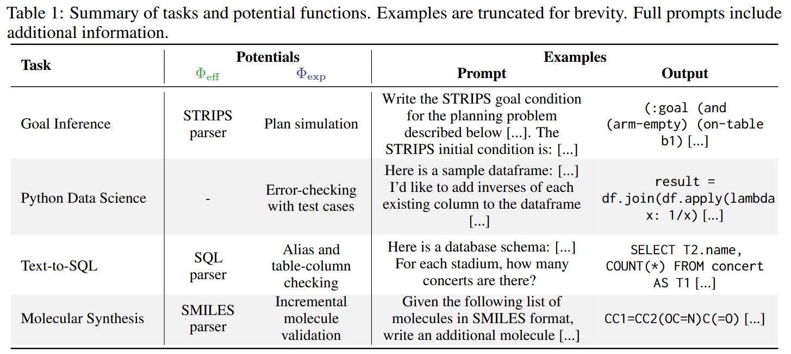
Experimental Settings

Slide 15
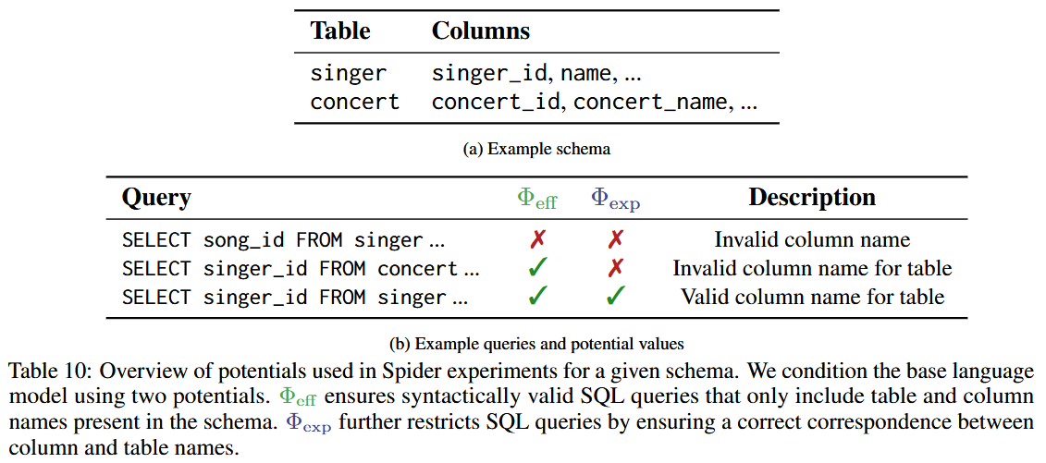
Example potentials

Slide 16
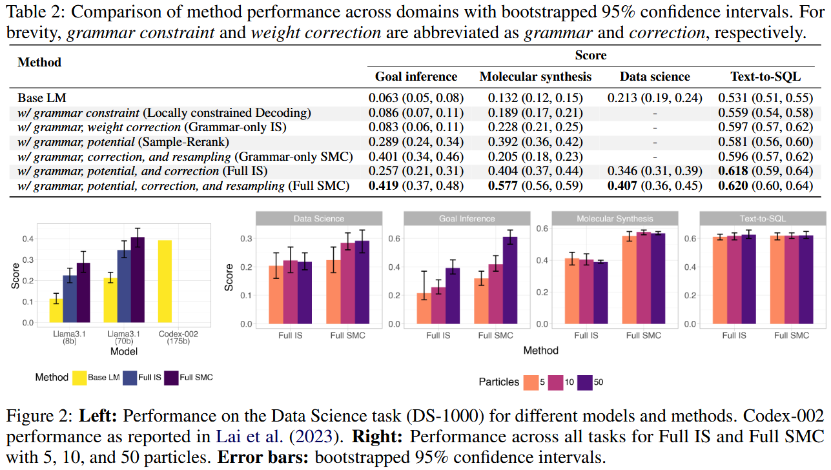
Experimental Results
Notes:
Grammar constraints
Expensive potentials
Weight corrections

Slide 17
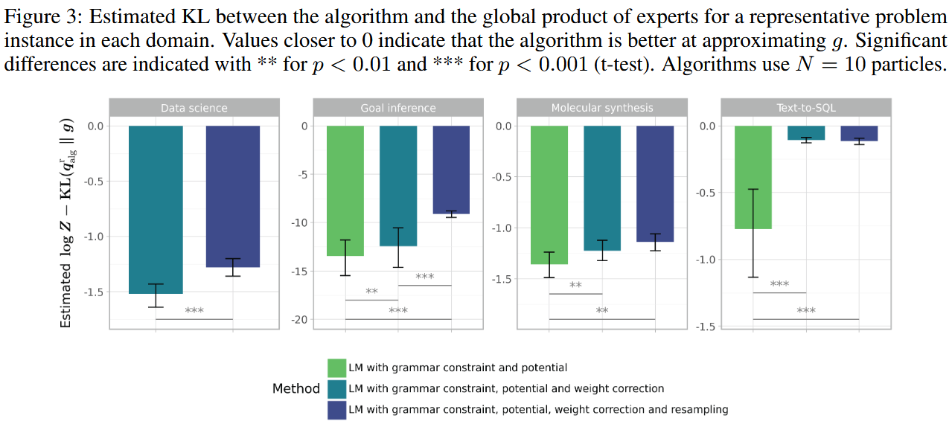
Validation of the Probabilistic Perspective

Slide 18
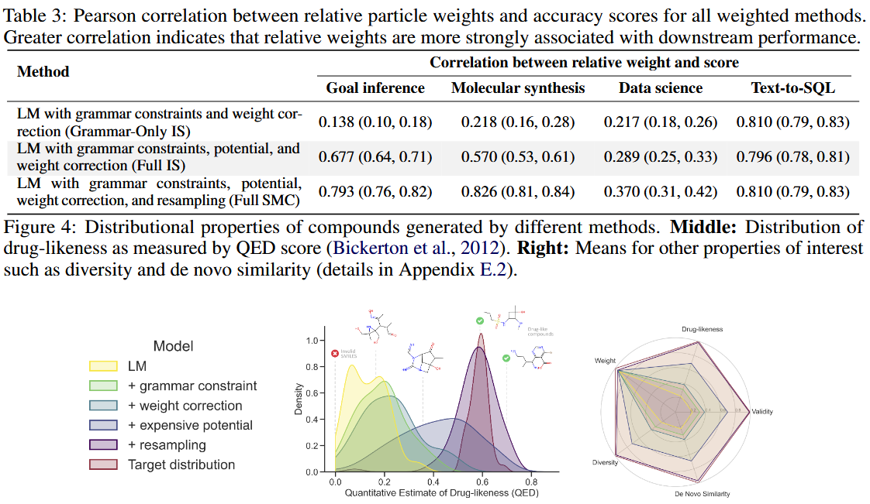

Slide 19
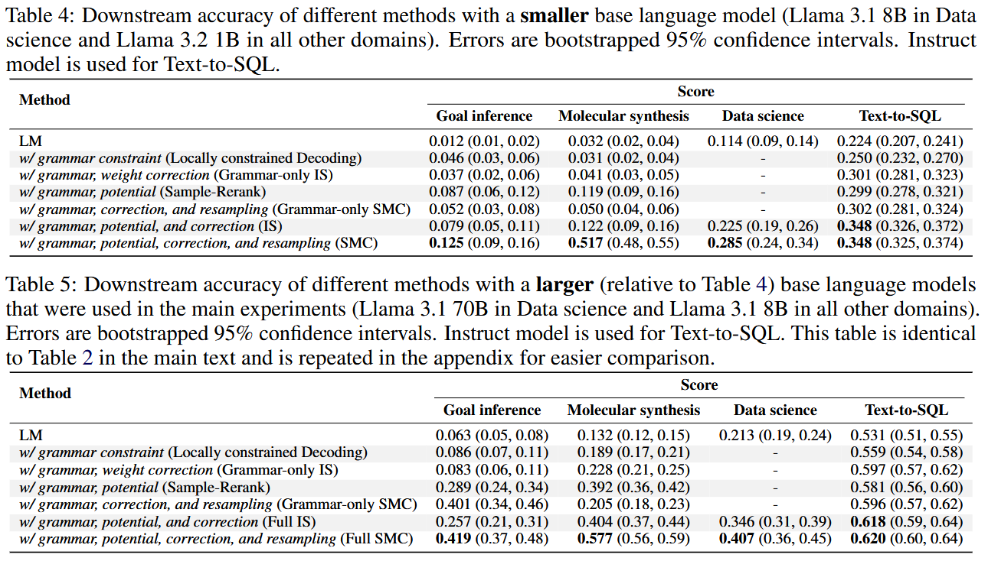
More results on differently-sized LMs

Slide 20
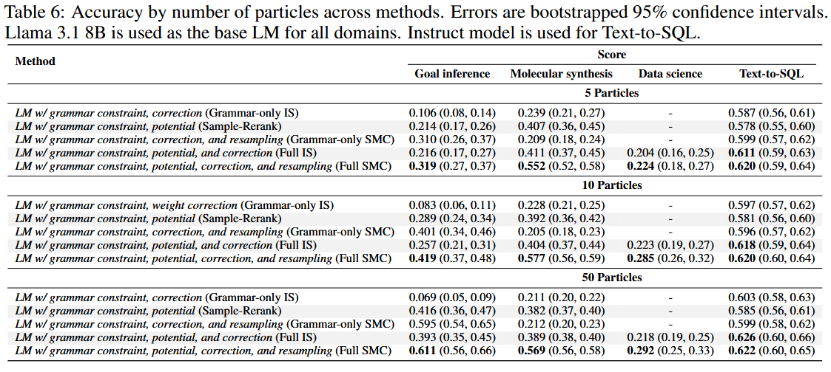
More results on different number of particles

Slide 21
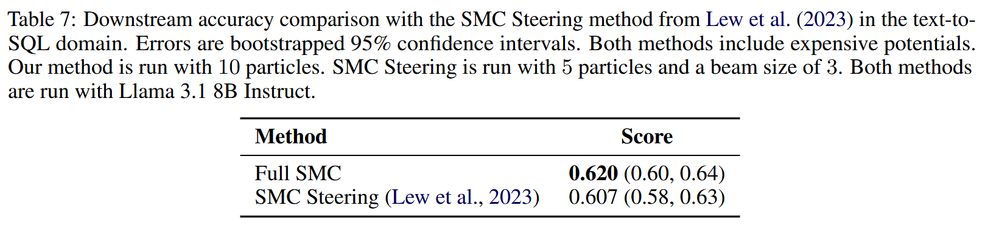
Comparison with SMC Steering

Slide 22
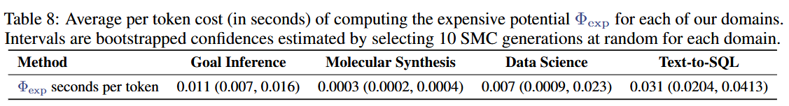

Average per-token cost for $Φ_{exp}$

